Slide 1
Pre-assessment Questions
  Predict the output of the expression, 16 % 3?
    5
    0
    1
    4
  What is the default value of the float data type?
    0.0
    0
    1.0
    1

Slide 2
Pre-assessment Questions (Contd.)
  3. Consider the statements:
Statement A: The name of a variable can begin with a digit.
  Statement B: The name of a variable can contain white spaces.
  Identify the correct option.
    Statement A is true and statement B is false
    Statement A is false and statement B is true
    Both, statements, A and B, are true
    Both, statements, A and B, are false

Slide 3
Pre-assessment Questions (Contd.)
  _______variables are the local variables that are accessed by the function in which the variables are declared.
    Static
    Automatic
    Instance
    Class
  _______literals are enclosed in single quotes
    String
    Character
    Boolean
    Integer

Slide 4
Solutions to Pre-assessment
Questions
  c.
  a.
  d.
  a.
  b.

Slide 5
Objectives
  In this lesson, you will learn to:
    Use operators
      Arithmetic assignment operators
      bit-wise operators
      shift operators
      instance-of operator
    Identify the operators precedence

Slide 6
Using Unary Operators
  Using the Increment and Decrement Operators
    The increment and decrement operators are unary operators.
    The increment operator (++) increases the value of an operand by 1.
    The decrement operator (--) decreases the value of an operand by 1.
    Prefix Form
      The operator precedes the operand.
      Operator operates on the operand before the value of operand is used in the expression.
    Postfix Form
      In the postfix form, operator follows the operand.
      Operator operates on the operand after the value of operand is used in the expression.

Slide 7
Using the Arithmetic Assignment Operators
  Arithmetic Assignment Operators
    Addition(+), subtraction(-), multiplication(*), division(/), and modulo(%) are the arithmetic operators supported by Java.
    Various arithmetic operators, such as +, -, /, *, and % are combined with the assignment operator (=) and are called arithmetic assignment operators.

Slide 8
Using the Arithmetic Assignment
Operators (Contd.)
Operator
Use
Description
+=
op1 += op2
Adds operand, op1 and operand, op2 and assigns the result to op1. This expression is equivalent to op1 = op1+op2.
- =
op1 -= op2
Subtracts operand, op2 from operand, op1 and assigns the result to op1. This expression is equivalent to op1 = op1 – op2.

Slide 9
Using the Arithmetic Assignment
Operators (Contd.)
Operator
Use
Description
*=
op1 *= op2
Multiplies operand, op1 and operand, op2 and assigns value of the result to op1. This expression is equivalent to op1 = op1*op2.
/=
op1 /= op2
Divides operand, op1 by operand, op2, and assign the value of the result to op1. This expression is equivalent to op1 = op1/op2.

Slide 10
Using the Arithmetic Assignment
Operators (Contd.)
Operator
Use
Description
%=
op1 %= op2
Assigns the remainder of division of operand, op1 and operand, op2 to op1. This expression is equivalent to op1 = op1% op2.

Slide 11
Using Bit-wise Operators
  Bit-wise operators
    Operate on the individual bits of their operand.
    Operands can be various data types like int, short, long, char, and byte.
    Operands are converted into their binary equivalents before operation.
    The result in the binary form after the operation is converted back into its decimal equivalent.

Slide 12
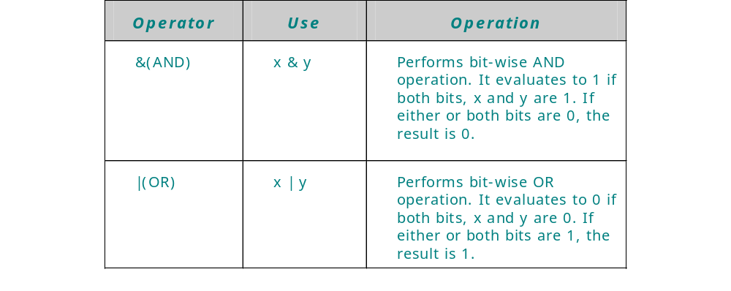
Using Bit-wise Operators(Contd.)
  The following table lists the various bit-wise operators in Java:

Slide 13
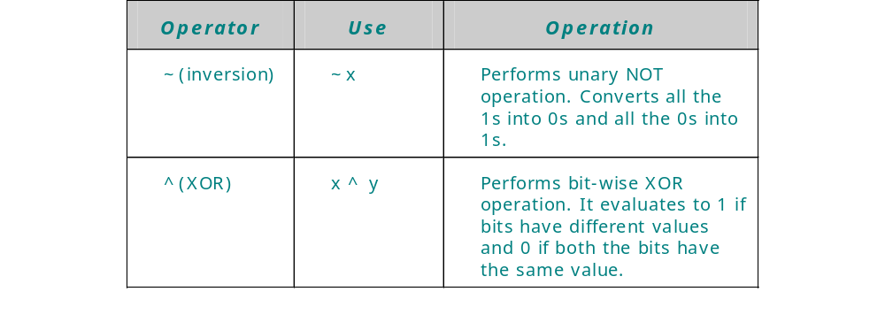
Using Bit-wise Operators(Contd.)

Slide 14

Using Bit-wise Operators (Contd.)
Using the Bit-wise AND Operator
  The Bit-wise AND operator (&) performs AND operation on two operands.
  Displays 1 if both bits are 1 else 0 in all other cases.

Slide 15

Using Bit-wise Operators (Contd.)
Using the Bit-wise OR Operator
  The Bit-wise OR operator (|) performs OR operation on two operands.
  Displays 0 if both bits are 0 else 1 in all other cases.

Slide 16

Using Bit-wise Operators (Contd.)
Using the Bit-wise NOT Operator
  Bit-wise NOT operator (~) is a unary operator and performs NOT operation on each bit of binary number.
  The NOT operator inverts or complements each of the bits of a binary number.

Slide 17

Using Bit-wise Operators (Contd.)
Using the Bit-wise XOR Operator
  The Bit-wise XOR (^) operator performs XOR operation on two operands.
  The XOR operator applied on two bits results in 1 if exactly one bit is 1 else 0 in all other cases .

Slide 18
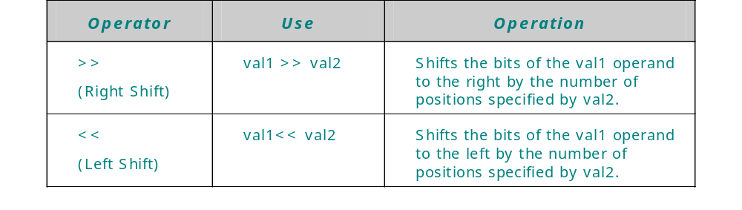
Using Shift Operators
  Works on the bits of data.
  Shifts the bits of it’s operand either to left or right.

Slide 19
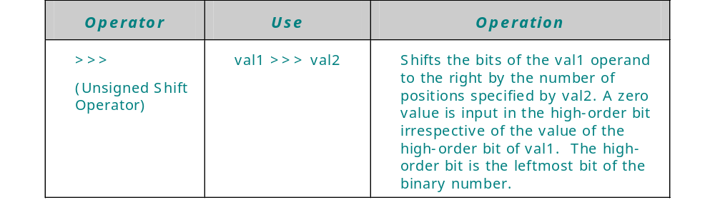
Using Shift Operators (Contd.)

Slide 20
Using Shift Operators (Contd.)
Using the Right Shift and Left Shift Operators
  The right shift and the left shift operators are binary operators.
    The right shift operator shifts all the bits of a binary number in the right direction.
      operand >> num
    The left shift operator, <<, shifts all the bits of a binary number in the left direction.
      operand << num
Using the Unsigned Shift Operator
  Unsigned shift operator (>>>) is used to shift the bits of a binary number to the right.
  The operator fills the leftmost bits of a binary value with 0 irrespective of whether the number has 0 or 1 at the leftmost bit.

Slide 21
Using instance of Operator
  Used to test whether an object is an instance of a specific class.
  Used at the run time.
  The syntax of the instanceof operator is:
  op1 instanceof op2
  op1 is the name of an object and op2 is the name of a class.
  Returns a true value if the op1 object is an instance of the op2 class.

Slide 22
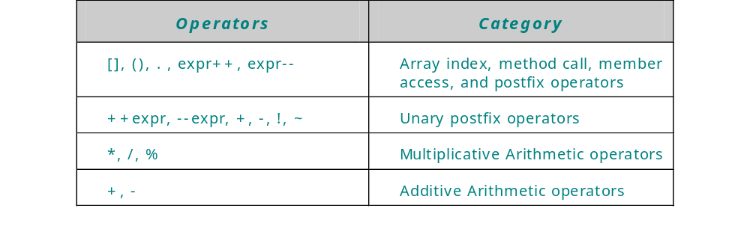
Operators Precedence
  Each operator in an expression is evaluated in a predetermined order called operator precedence.
  Operators on the same line have equal precedence.

Slide 23
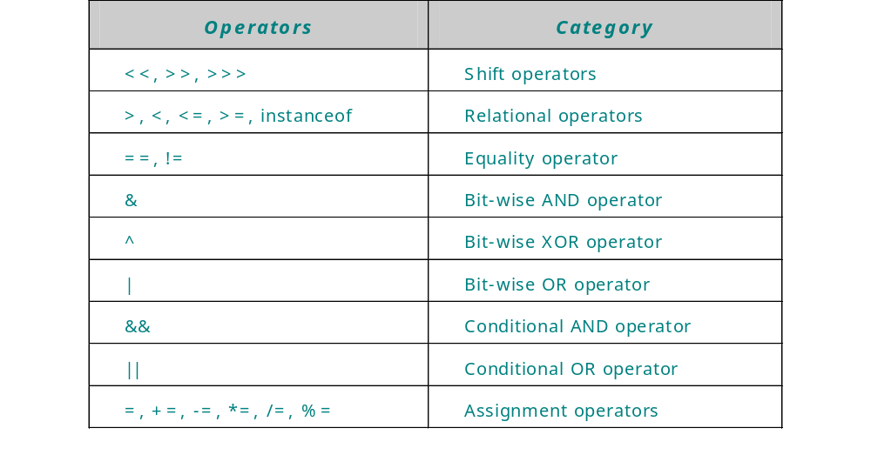
Operators Precedence(Contd.)

Slide 24
Demonstration-Precedence of
Operators in Java
  Problem Statement
    Create a Java application to understand the order of precedence of various operators in Java.
  Solution
    The Java application is created using the various operators in Java.
    To solve the above problem, perform the following tasks:
    Code an application with an expression having multiple operators of different precedence
    Compile and execute the code.

Slide 25
Summary
  In this lesson, you learned:
    Operators are used to calculate, compare and compute values. The operators are classified as:
      Unary operators
      Binary operators
    Unary operators operate on one operand, such as increment and decrement operators.
    Binary operators operate on two operands, such as arithmetic operators +,-,/,*.
    Arithmetic operators, such as, +, _, combined with assignment operator(=) are arithmetic assignment operators.
    Bit-wise operators operate on one bit at a time.
    The bit-wise operators operate on data types such as, int, short, long, char and byte.
    The various bit-wise operators are bit-wise AND (&), bit-wise OR (|), bit-wise NOT (~), and bit-wise XOR (^).

Slide 26
Summary (Contd.)
  Shift operators are used to shift the bits of the number to the left or right. The various shift operators are right shift (>>), left shift (<<), and unsigned shift operator (>>>).
  The instanceof operator is used to test that whether an object is an instance of a particular class.
  An expression can have several operators and each operator is evaluated in order of their precedence.

